Slide 1

WebSockets + WebRTC
Realtime Study Rooms Tutorial
Team 10
Amish Kakka Suryansh Purohit Sahithi Karangala Harshvardhan Kuthadi
Notes:
"Hi, we are [names], and this is our SER 421 final project.
Our topic is WebSockets and WebRTC, and we wrapped those into a tutorial and a working demo called Realtime Study Rooms.
The idea is: instead of just reading about realtime web tech, the learner walks through a structured tutorial, then builds a study-room app with live chat, presence, and video calls.
The project deliverables are a tutorial web site with modules and references, plus a demo app with both a full implementation and a starter version that students can work from.
In this talk we will walk through what the tutorial teaches, how the demo is built, and a short analysis of when this tech is actually worth using.

Slide 2
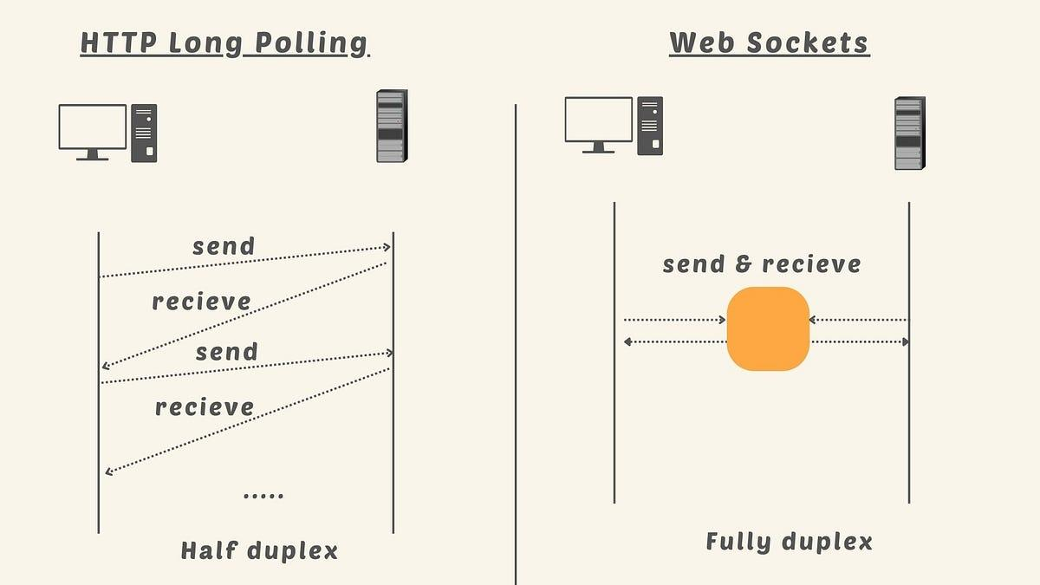
Why WebSockets + WebRTC?
Modern App Needs:
Live chat, presence, and collaboration
Low latency audio/video
The HTTP Limit:
Struggles with server push and efficient realtime updates
The Solution:
WebSockets: Long-lived, bidirectional connection
WebRTC: Peer-to-peer media in the browser
Notes:
Before jumping into the tutorial, we wanted to ground why this topic exists.
Modern web apps are not just CRUD over HTTP anymore. Things like collaborative editors, multiplayer games, and video calls all need low latency, bidirectional communication and awareness of who is online right now.
Plain HTTP is great for request response, but it is awkward for realtime: you end up polling or long polling, which is wasteful and still laggy.
WebSockets fix the transport side by giving you a long lived, bidirectional channel between browser and server. That works well for chat, presence, and also as a signaling channel.
WebRTC then tackles the media side. It lets browsers establish peer to peer audio and video connections, while still using something like WebSockets underneath to exchange offers, answers, and ICE candidates.
Our tutorial leans into that combination: we use WebSockets for state and signaling, and WebRTC for media, all wrapped around a study room app that actually feels like something you might build in the real world.

Slide 3
What have we delivered?
Tutorial Site | Demo Application
Module 1: Concept, History and Motivation on WebSockets and WebRTC | Dev Branch: Full implementation of WebSockets + WebRTC application
Module 2: Technology understanding and views on the current standards | Starter Branch: Includes UI with TODOs aligned to Module 3 steps
Module 3: Hands-on "Real Time Study Rooms" building

Slide 4
Learning Outcomes and Traceability
Core Outcomes | Traceability
Explain when to use WebSockets vs. HTTP | Module 1 & 2
Describe WebRTC signaling and ICE/STUN/TURN architecture.
Implement realtime lobby, chat, and presence (WebSockets). | Module 3 - The build section
Implement lightweight signals (typing indicators, reactions).
Build a group video call (WebRTC).
Evaluate the tradeoffs of stateful connections. | Module 2 - Analytical Section

Slide 5
Background: History & Standards
WebSockets (RFC 6455):
Standardized to replace polling hacks.
Provides a full-duplex TCP connection over a single HTTP upgrade.
WebRTC (W3C + IETF):
Joint effort for plugin-free browser media.
ICE/STUN/TURN: Standards for NAT traversal and connectivity.
Signaling: Intentionally left undefined (we use WebSockets).

Slide 6
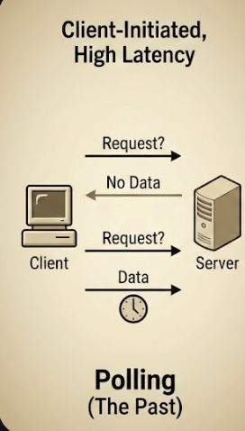
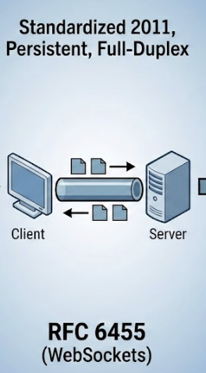
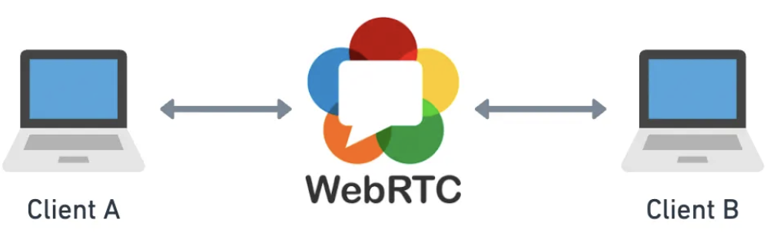
Direct peer-to-peer
Standardized in 2017

Slide 7
Demo Architecture
Backend:
Node.js server using ws library.
Single endpoint handles: Lobby state, Chat, Reactions, and WebRTC Signaling.
Frontend:
React Client with useWebRTC custom hook.
Manages RTCPeerConnection and DOM video elements.
The Novelty:
Learners build the integration of two distinct protocols (WebSockets + WebRTC).

Slide 8
Show live demo of our application

Slide 9
Phase 1: WebSockets (Steps 0–7)
Goal: Turn static UI into a realtime app.
Key Activities:
Step 2: Connect & Identify (Client IDs).
Step 3-4: Realtime Lobby (Room Lists, Create/Join).
Step 5: Synchronized Chat History.
Step 7: Lightweight Signals (Typing indicators, Reactions).
Checkpoint: Two tabs see the same state instantly.

Slide 10
Phase 2: WebRTC (Steps 8–11)
Goal: Layer video calling on top of the WebSocket connection.
Key Activities:
Step 8: Define Signaling Protocol (Offer, Answer, ICE Candidates).
Step 9: Local Media (getUserMedia).
Step 10: Remote Peers (Handling ontrack events).
Step 11: Media Controls (Mute/Unmute) & Cleanup.

Slide 11
Analysis: Is it worth the complexity?
Pros:
Low Latency: Essential for gaming and collaboration.
Native: No plugins required for HD video.
Challenges:
Complexity: State management is harder than stateless REST.
Infrastructure: Requires maintaining persistent connections; Scale is harder.
Connectivity: Corporate firewalls often require TURN servers.
Verdict: Excellent for collaboration apps, but overkill for simple CRUD data entry.

Slide 12
References & Future Work
Future Work:
Live Code Editor: Adding a 'Code' tab with a Monaco editor for collaborative coding.
Rich Presence: Animations for 'Coding', 'Typing', or 'Thinking'.
Key References:
RFC 6455 (The WebSocket Protocol).
W3C WebRTC 1.0 Candidate Recommendation.
MDN Web Docs (Media Streams API).

Slide 13
Q&A

